Slide 1

save and restore - with meta graph

Slide 2
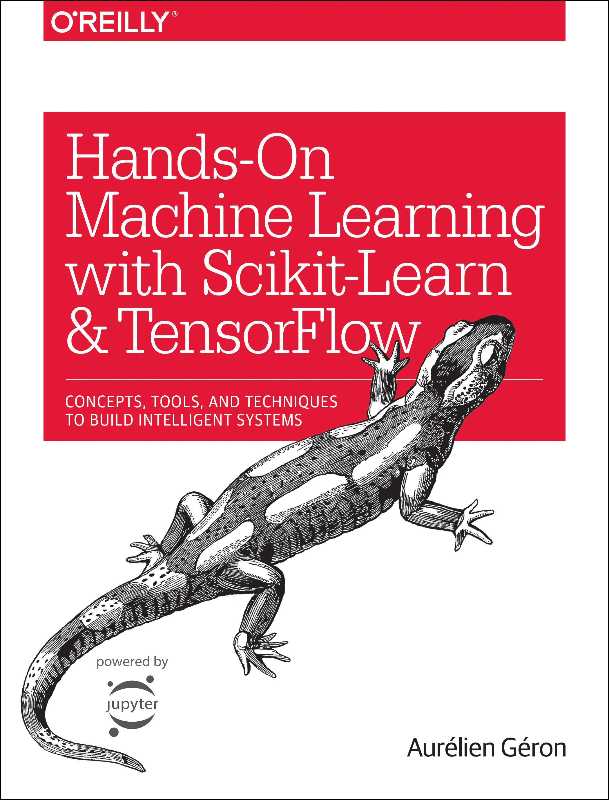
Reference
Chapter 11 (O'Reilly) of Hands-On ML
Youtube
Code

Slide 3
Data

Slide 4
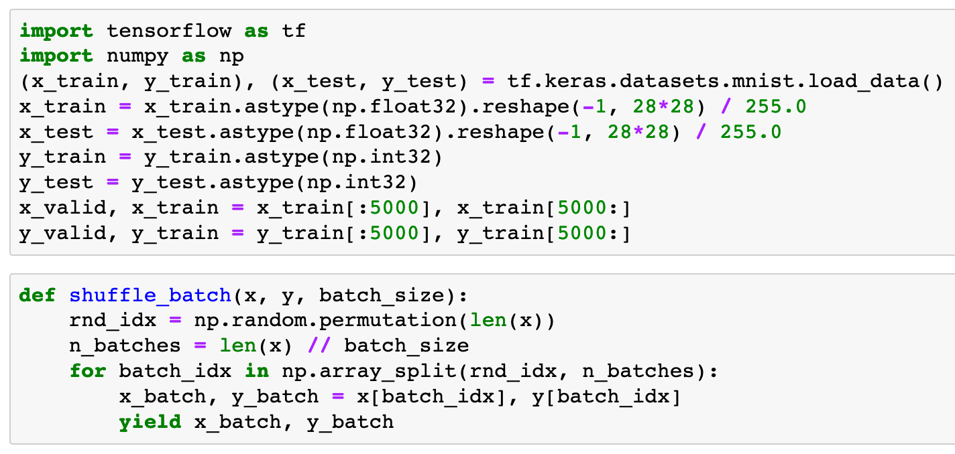


Slide 6
Warm Up

Slide 7
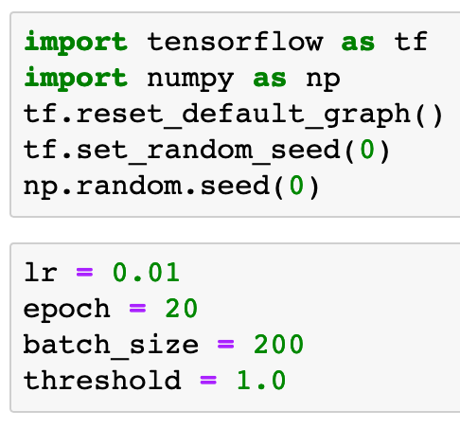

Slide 9
Graph

Slide 10
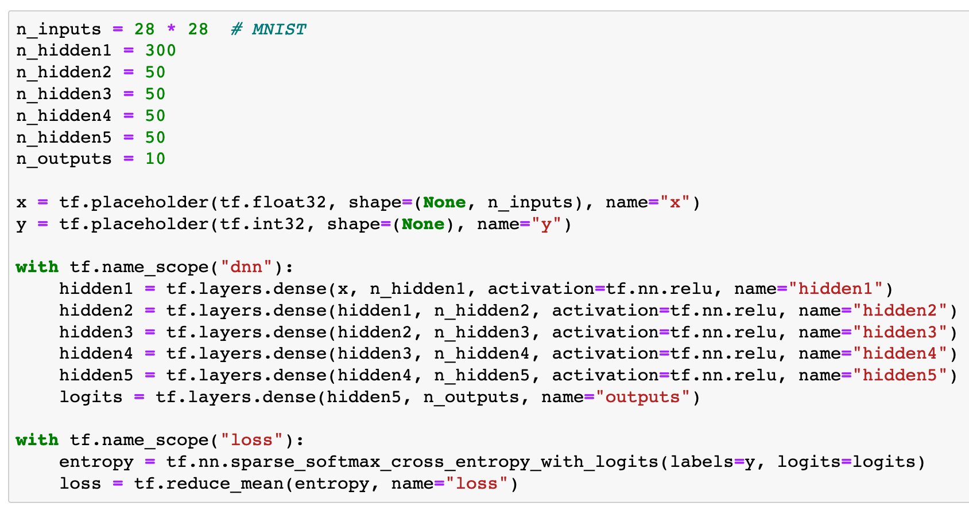

Slide 11
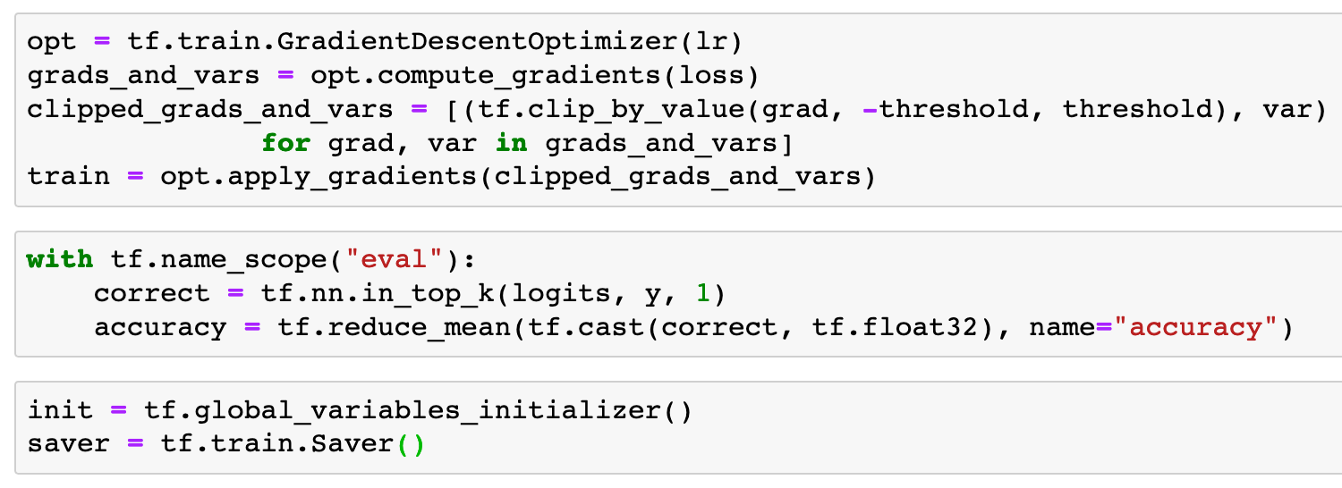

Slide 14
Session

Slide 15
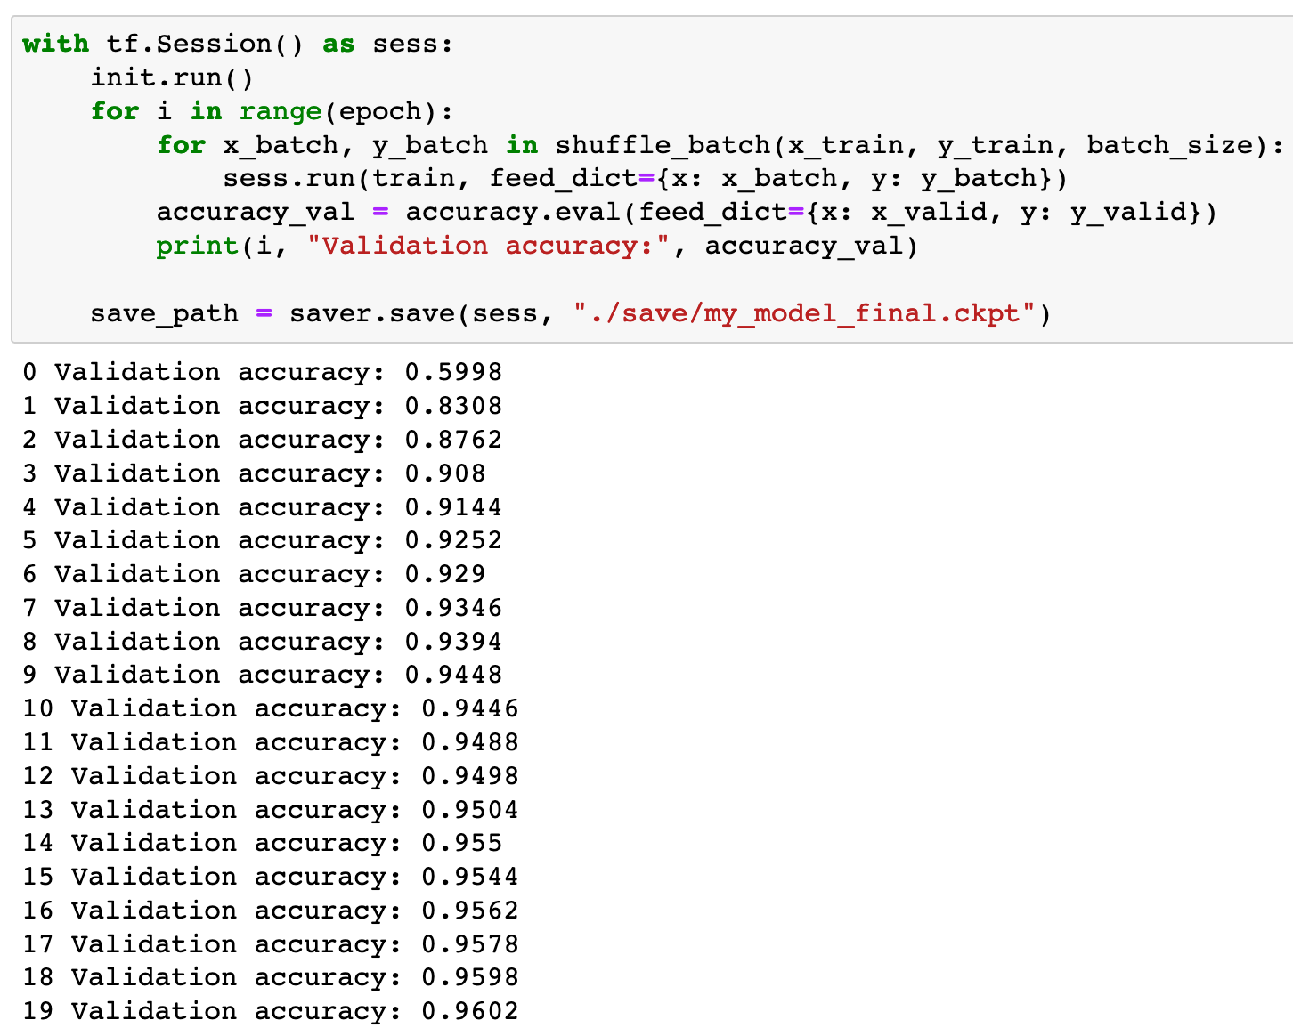

Slide 16
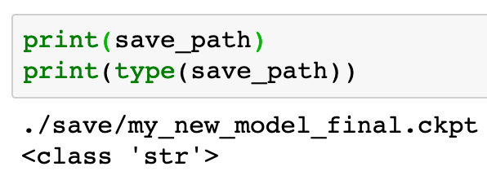

Slide 17
Restore

Slide 18
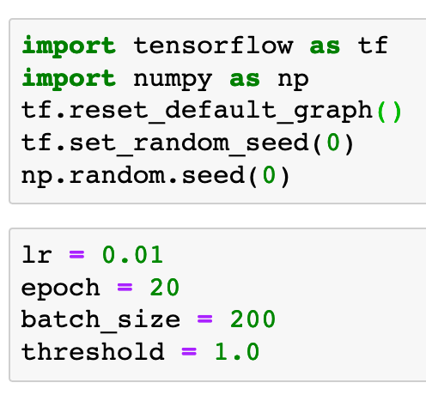

Slide 19
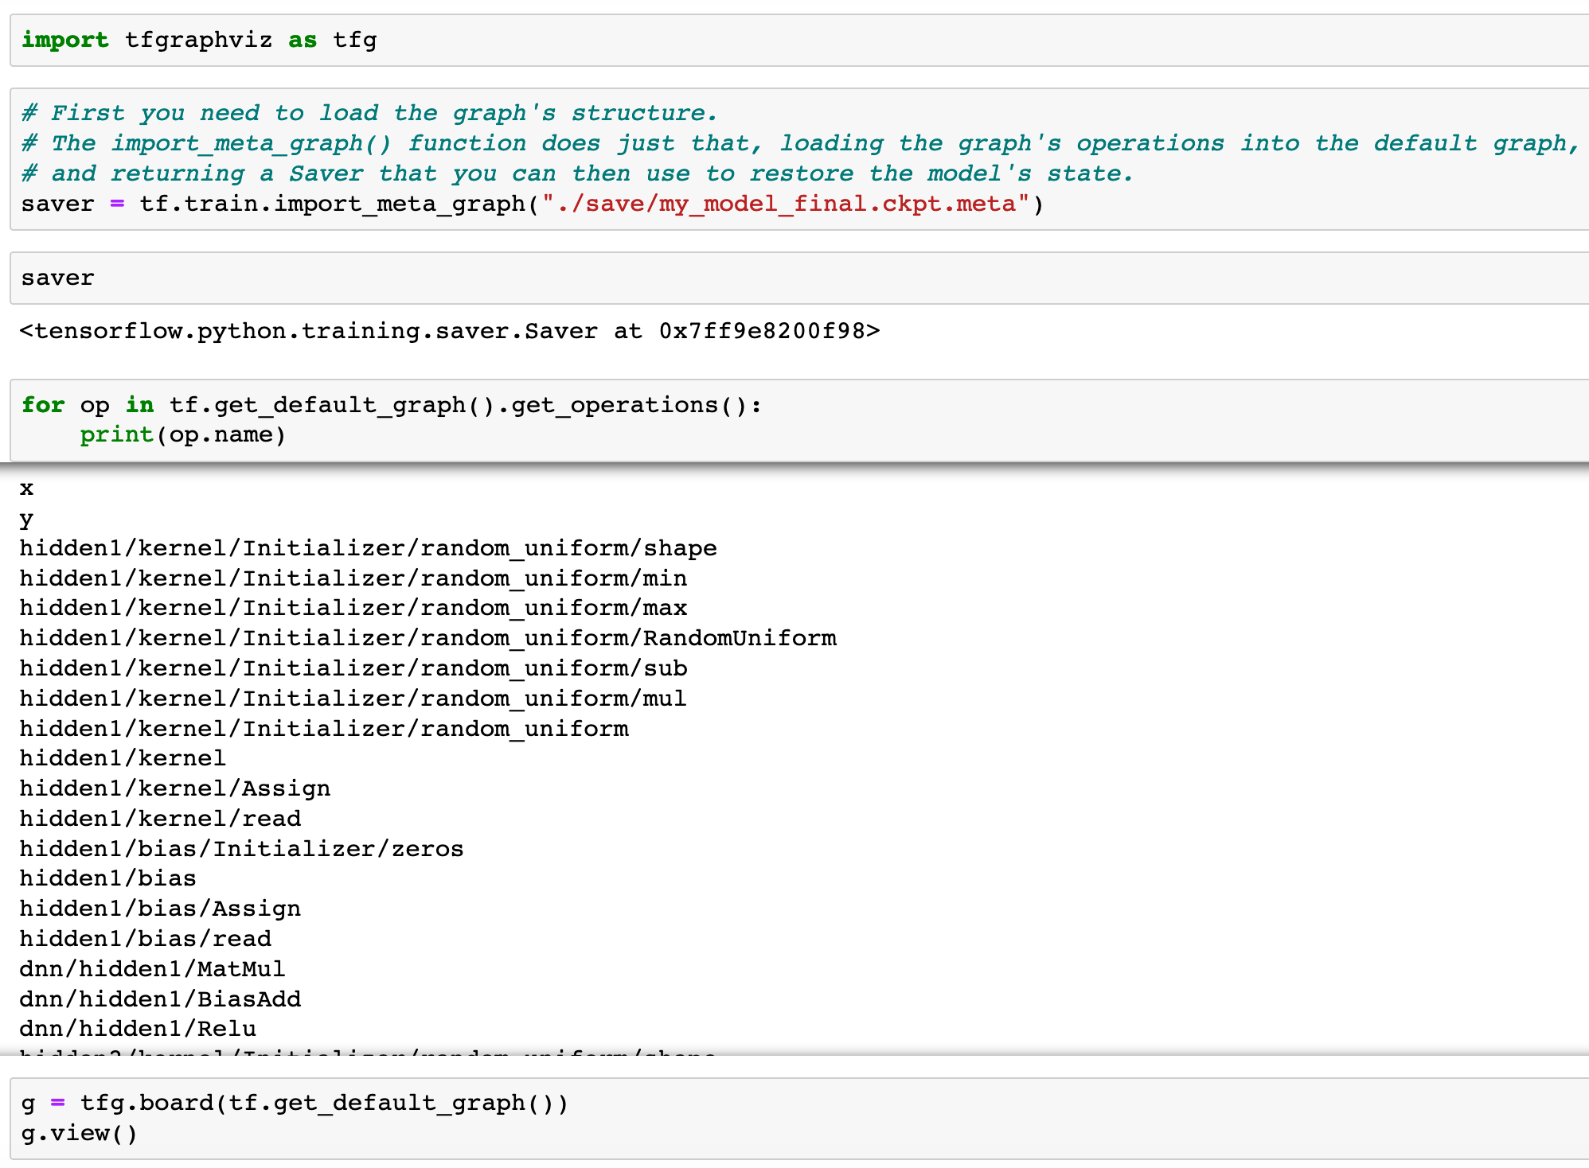

Slide 24
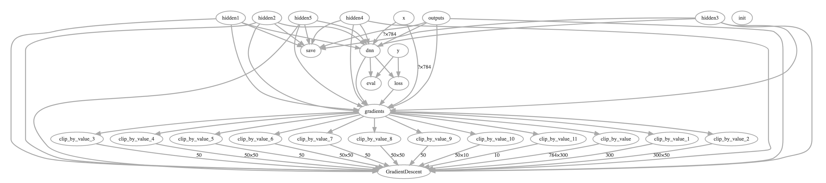

Slide 25
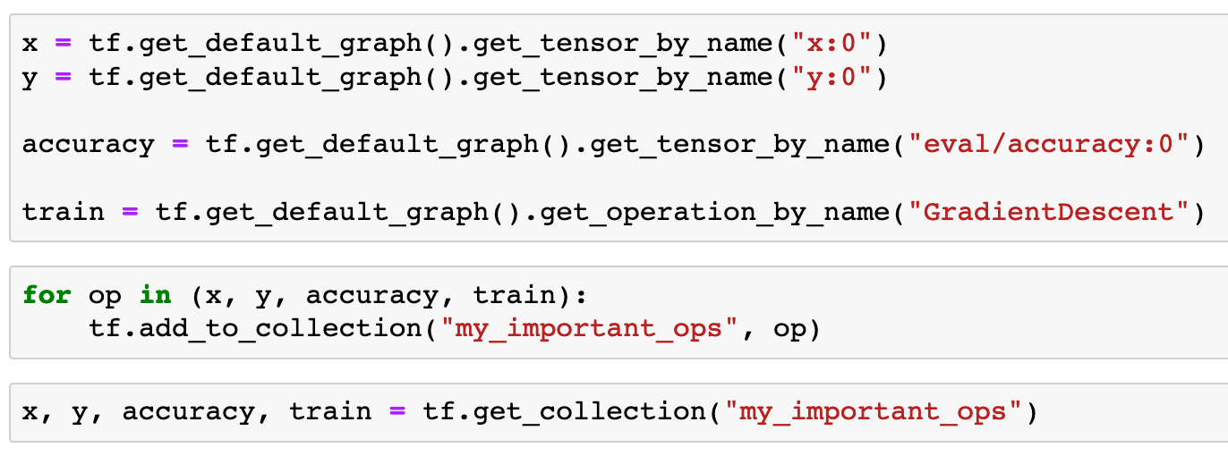

Slide 28
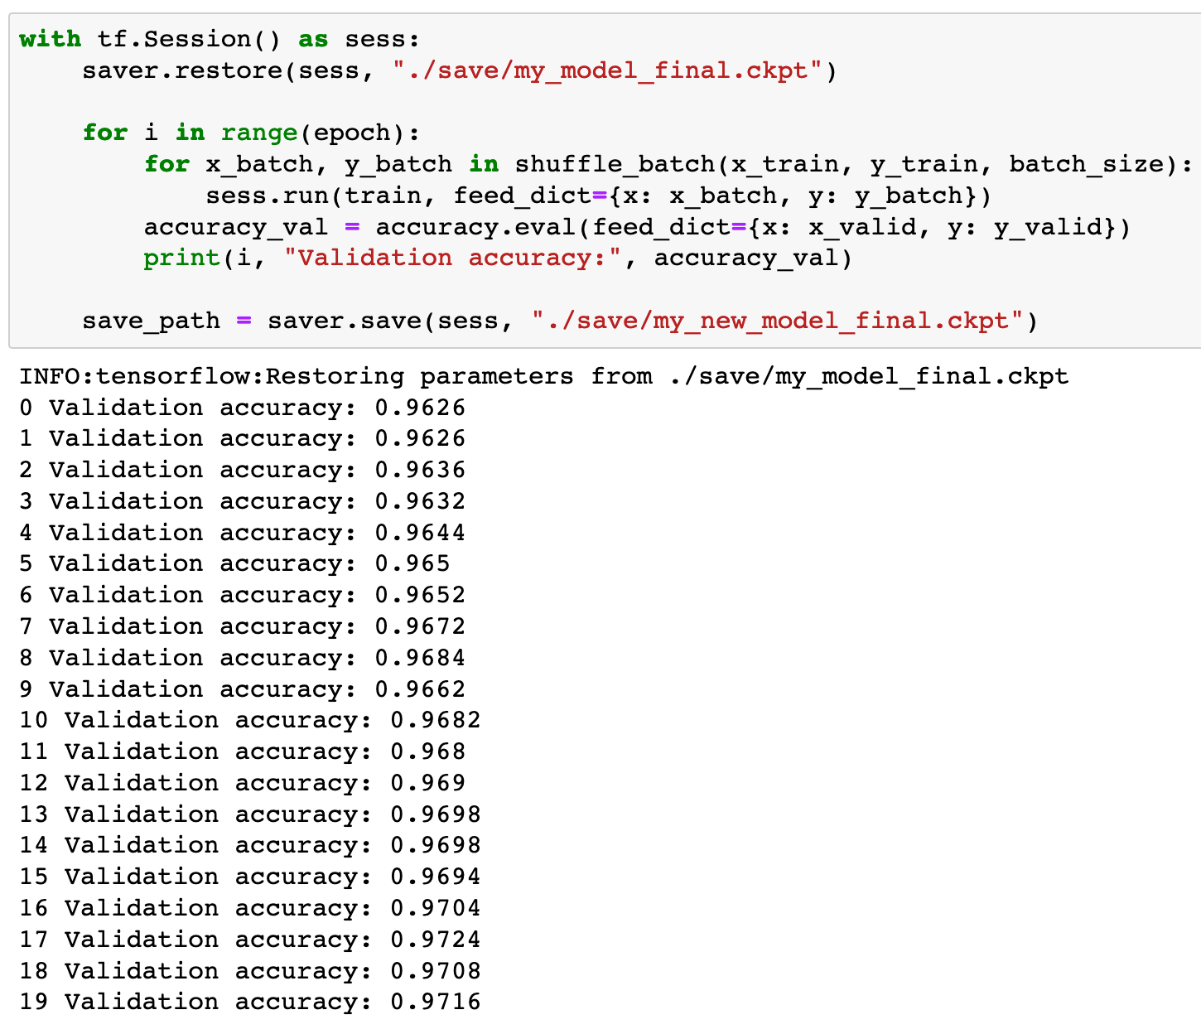

Slide 29
Now
Let’s Play with Code

